Slide 1
UML Overview

Slide 2
What is UML?
Universal Modeling Language
- Created during the OO ascendance
- Before – every company uses their unique notation
- An attempt to have a consistent way to diagram out
  - Architecture -> high-level structures
  - Design -> class diagrams
  - Requirements -> use case diagrams
In the case of Requirements, UML was heavily touted as ‘the’ way to show Use Cases

Slide 3
Types of diagrams
Class diagram
Object diagram
Use case diagram
Sequence diagram
Collaboration diagram
Activity diagram
Statechart diagram
Deployment diagram
Component diagram
We’ll cover some
  Starting with use case diagrams

Slide 4
UML Hierarchy
UML
Structural
Behavioural
Structure
Object
Class
Component
Package
Deployment
Activity
Use Case
State
Interaction
Sequence
Communication
Timing

Slide 5
Notation: Class & Object
Underline indicates object
Classes
Objects
Visibility
+: public
-: Private
#: Protected
Name
Attributes
Methods
Optional information
What’s the difference between a class and an object?
Notes:
Class diagram – blueprint (what the system can have)
Object diagram – specific case / execution snapshot (existence, connections, values)

Slide 6
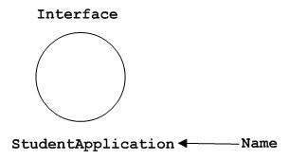
Notations
Interfaces: A circle with a name

Slide 7
Notation: Inheritance and Association
Passengers
Child
Parent
0..*
Generalization (increasing)
Aeroplane
Inheritance
Association

Slide 8
Notation: States
System behaves differently depending on its state
Routes between states
ATM Transaction
Initial State
Final State

Slide 9
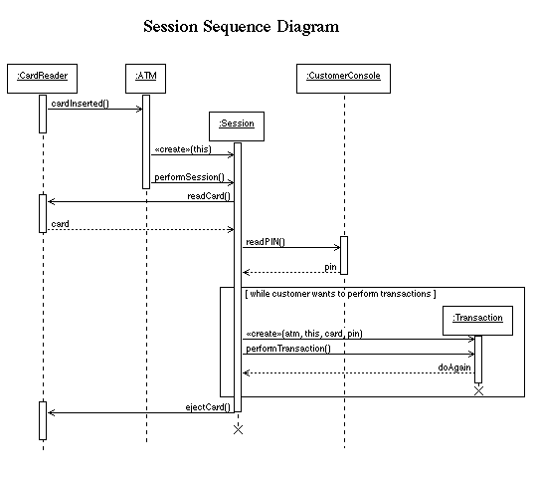
Interaction diagrams
Communications between objects

Slide 10
Sequence Diagrams

Slide 11
Sequence Diagrams
The
classes
Client
Supplier
Client object
Supplier object
PerformResponsibility()
PerformAnotherResponsibility()
Object Lifeline
: Client
: Supplier
Reflexive message
(Message to self)
1. PerformResponsibility
1.1. PerformAnotherResponsibility
Message
Hierarchical message numbering
Focus of Control
(Activation)
Sequence diagrams illustrate how objects interact with each other dynamically

Slide 12
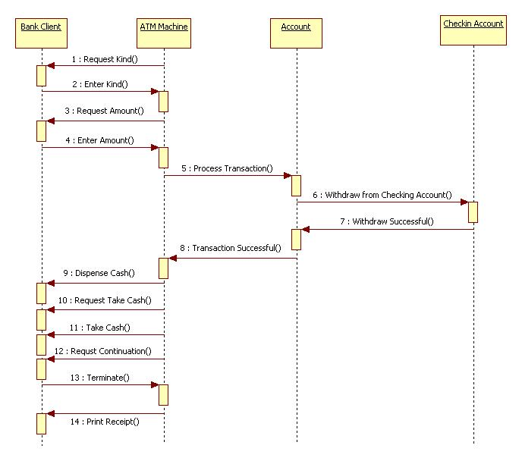
ATM Withdrawal

Slide 13
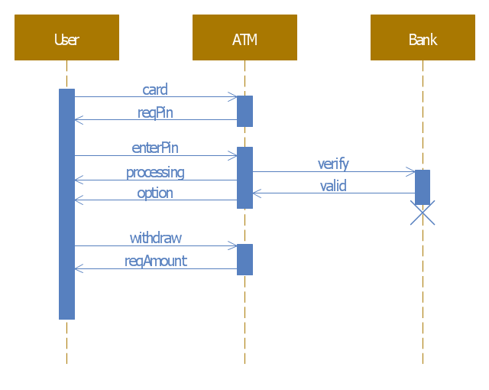
ATM Withdrawal (slightly different objects and style)

Slide 14
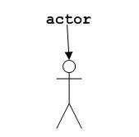
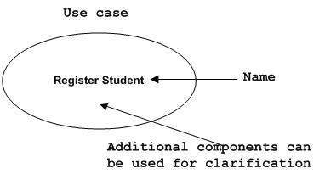
Components of Use Cases
Intent
- To show the software from the perspective of the user
The actor
The use cases

Slide 15
The shift in focus
Once the gold standard, UML has reduced in usage for a few reasons:
- Complexity in notation
- Time to create
- Lack of clarity
Often not followed fully (and it’s fine)
So why talk about it?
- Some parts are still very relevant
  - Sequence diagrams, Swim Lanes, …
- You may run into this in interviews or on the job (UML has been around, and legacy lives on!)

Slide 16
References
https://www.tutorialspoint.com/uml/uml_basic_notations.htm
http://empirical-software.engineering/assets/pdf/fse14-sketches-slides.pdf

